Slide 1

Financial Literacy
By
Plot 9a, Ntinda View Crescent, Kampala.
P.O. Box 101546 Kampala, Uganda .
Telephone: +256 770 555505
Web: https://edify.org/uganda
Plot 67-173, Mukono Hill, Bishop Tucker Road
P.O. Box 4, Mukono, Uganda
Telephone:+256 312 350 800.
Email: info@ucu.ac.ug. Web: www.ucu.ac.ug.

Slide 2
A
Presentation
to
Christian Founded Private Schools in Uganda

Slide 3
“Failing to plan is planning to fail”
Benjamin Franklin and Sir Winston Churchill

Slide 4
Outcomes
By the end of this session, participants should be in position to:
  Define financial literacy
  Explain the different formats of financial management

Slide 5
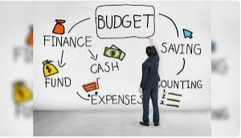
Financial Literacy Defined
Financial literacy is the capability to appreciate and make use of a diversity of financial skills, including personal financial management, budgeting, and investing.

Slide 6


Financial Literacy
Have a 3 – 5 strategic plan to avoid unnecessary expenditures.
Budget your resources annually ranging from daily expenses to payroll
Spend as per the budget (prioritize your expenditures)
In case of scarcity, touch not recurrent expenditures e.g. salaries
Manage all school finances through the bank

Slide 7
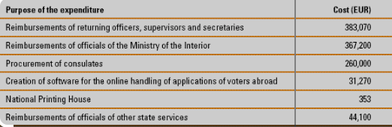



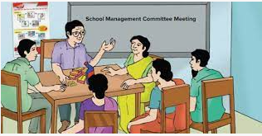
Financial Literacy Cont’d…
Develop votes for your expenditures
Have between two – three signatories to your school account
In case of capital developments, have a reserve below which you cannot spend
Have both end of term and end of year reviews to evaluate the financial reports of your financial resources.
Have a school management committee to receive, approve and review your financial reports

Slide 8



Financial Literacy Cont’d…
As your school grows, professionalize it, hands off, eyes and ears in.
Meet all your obligations (e.g. Rent, taxes, and loans) on time to avoid penalties and/ or disappointments.
.
Have an internal audit team and if possible, the external audit as well.
.

Slide 9



Financial Literacy Cont...
v
Record all your incomes including
Fees collection
Grants
Donations
None fees collections like uniforms, meals, school requirements, transport etc.
Record all your expenditures including:
Salary
Capital infrastructure development
Food
Accommodation
Allowances
Rent
Fuel
Taxes
NSSF etc.

Slide 10
Invest the Excess Money at your disposal
Invest the excess money you do not need apparently through
Buying Securities and / or Bonds
50%
Open a fixed account
35%
Buy Land
35%
Look out for a saving account with better interest rate
35%

Slide 11
Avoid the following traps
Being greedy for loans without clear investment plan(s) .
Opening up new branches without stable source of finance to repay the loan .
Spending outside the budget estimations
Drawings for luxury
Unnecessary competition
Witchcraft
The beginning of your failure
Leads to unplanned expenditures
Drains the business
Chances are high to lose focus
Sunk costs are not recoverable
Be mindful of the repayment period

Slide 12

So What?!
Achieve and/or realize your long term goal or dream
Remain focused to grow your finances
Take time to plan

Slide 13


